Slide 1
AMSC 5710
Advanced Materials Characterization
Sample preparation

Slide 2
Contents
Sample preparation: An analytical perspective
Examples: for specific characterization
Creating vacuum environment

Slide 3
PHYS 5350 techniques in materials characterization
Sample preparation:
An analytical perspective

Slide 4
Sample preparation: An analytical perspective
Motivation of sample preparation
The purpose of an analytical characterization is to obtain information about an object or a substance.
The substance could be a solid, a liquid, a gas, or a biological material, chemical, nanomaterials, electronic system…….
Information to be obtained varies from chemical to physical composition, bulk to surface properties, structural to morphological information, chemical to physical and to biological phenomena.
NO single instrument can get all information from all types (or forms) of samples.
Need careful sample treatment and preparation!
Notes:
Why need sample prep
Fit in and get in touch with the probe
Clean sample avoiding artifact (vacuum)

Slide 5
Sample preparation: An analytical perspective
Importance of sample preparation
Sample preparation is often considered the "low tech" part of the method, and thus receives little attention. In some laboratories, the youngest, least experienced (and usually lowest paid) workers are assigned to the "Prep Lab." It is assumed that their inexperience will be less of a liability in this part of the organization.
Despite its "low tech" image, sample preparation is a critical part of every method. Although many procedures do not use sophisticated, and expensive, equipment, they still require considerable care in operation to ensure that reliable results are obtained.
All sample preparation procedures are based on sound chemical and physical principles. To successfully, and efficiently, use these procedures, you must understand these principles, and then apply your knowledge of them to the task at hand.
Often neglected, but is of critical importance!
Notes:
Importance: avoid artifacts introduction

Slide 6
Sample preparation: An analytical perspective
Steps in the measurement process
Should be representative of the original subject
Sampling should be done with variability within the object in mind
Sampling
Sample Preservation
Maintain the integrity of the sample between the time of sample collection and analysis
Avoid and assess potential contaminations and interferences
Sample Preparation
Involves sample treatment so that the desired information can be successfully obtained in subsequent analysis
Avoid introducing uncertainties and addition factors
Appropriate methods, calibration, experimental conditions, instruments
Valid and sound data analysis
Analysis

Slide 7
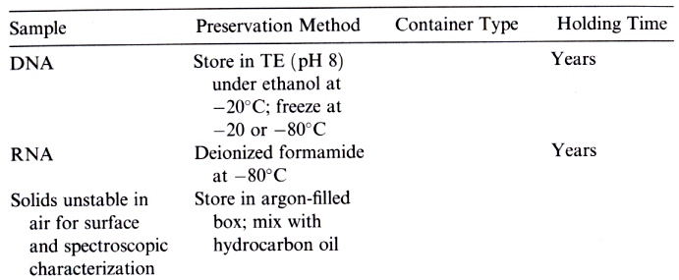
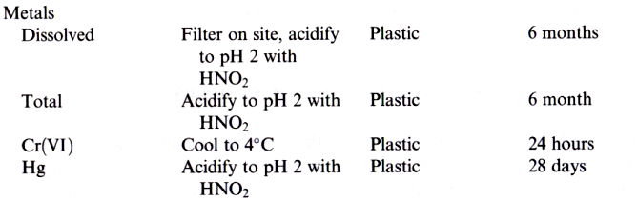
Quality assurance and quality control in sample preparation
Preservation of samples

Slide 8
Sample preparation: An analytical perspective
Possible steps in sample preparation
Homogenization, size reduction
Reduce sample in-homogeneity within the analysis volume
Avoid invariable size effect
Extract sample from potential interference
Avoid sample loss
Extraction
Pre-concentrate the sample for more accurate analysis
Need careful calibration
Concentration
Eliminate excess reagents used for extraction and concentration
Avoid significant sample loss
Clean-up
Analysis

Slide 9
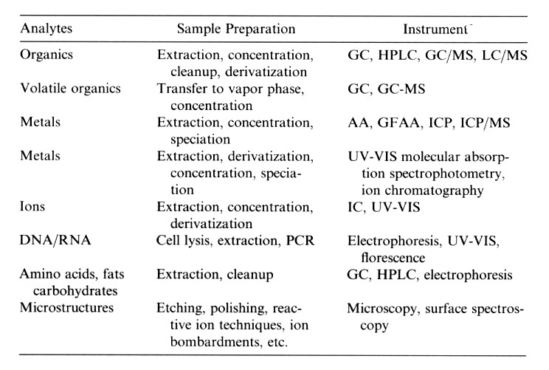
Sample preparation: An analytical perspective
Examples: Necessary sample preparation steps for specific analytes

Slide 10
Sample preparation: An analytical perspective
Classification of analysis/characterization
Qualitative analysis
Yes/no, presence/absence, strong/weak, …… about a particular property or information
Quantitative analysis
Quantified information on a particular property or information, e.g. concentration, dimension, intensity ……
Semi-quantitative analysis
The concern is not exactly how much is there but whether it is above or below a certain threshold level.

Slide 11
PHYS 5350 techniques in materials characterization
Sample preparation
for specific characterization
examples
A. Sample preparation for microscopic evaluation
B. Sample preparation for surface spectroscopy

Slide 12

Sample preparation for specific characterization
Metal sample preparation for microscopic evaluation
The crystal structure of a solid metal refers to the internal structure or arrangement of the atoms in an ordered, repeating, 3D pattern.
Normal metallic objects are polycrystalline, which means they consist of an aggregate of many very small crystals. These crystals are called grains.
Typically, the grains of a metal object are very small, and cannot be viewed with the naked eye.
The structural features of the small grains are observed using an optical or electron microscope.
Structures requiring this range of magnification for their examination are called microstructures.
$$μm$$

Slide 13
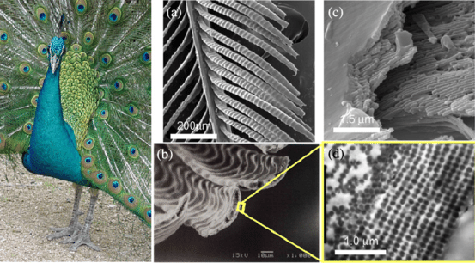
Example of microstructure
Notes:
A peacock tail feather features a central rachis (stem) from which barbs extend. Each barb bears numerous barbules, flat extensions about 20-30 micrometers wide with round indentations that scatter light.
Barbules consist of a thin medullary core (around 3 micrometers) encased in a keratin cortex containing a two-dimensional photonic crystal. This crystal comprises an ordered lattice of melanin rodlets (≈100-120 nm diameter, 0.7 μm long) embedded in keratin, forming a square or rectangular array with lattice constants of 140-165 nm

Slide 14
Sample preparation for specific characterization
Sample preparation for microscopic evaluation
What we look for in a microstructural analysis?

Slide 15
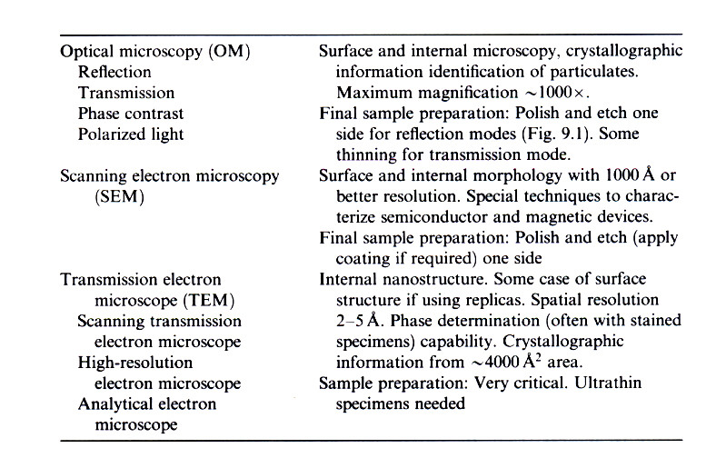
Sample preparation for specific characterization
Sample preparation for microscopic evaluation

Slide 16
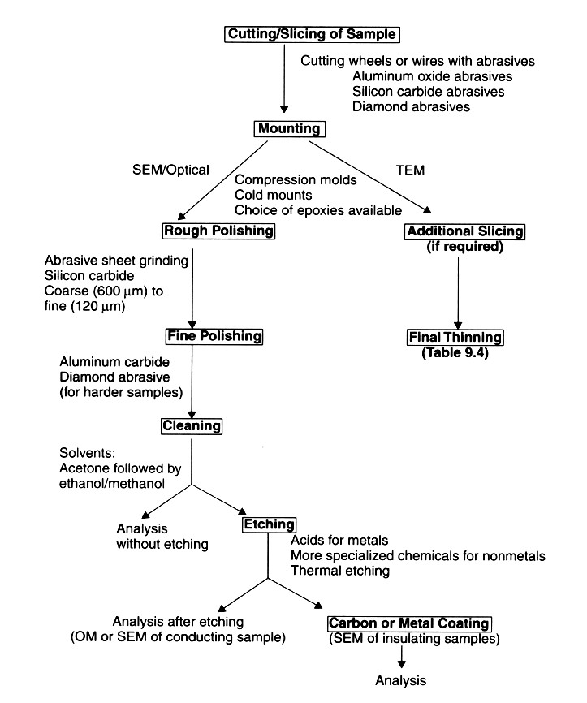
Sample preparation for specific characterization
Sample preparation for microscopic evaluation

Slide 17
Sample preparation for specific material characterization
Sample preparation for microscopic evaluation
Sectioning and Polishing
Sample prepared by sectioning to size appropriate for microscopic study.
With a regular saw, surface damage during sectioning can extend 200 μm or more into the sample. Use of narrower and thin cutting saw/blade (~100 μm thin) can reduce the surface damage to less than 1 μm. (Destroy the sample region we want to study?)
Mounting sample with appropriate epoxies. (Do these epoxies and mounting procedures affect the microstructures of the samples?)
Simultaneous lubrication and cooling with water, oil or alcohol is desirable. (Do these lubricants and cooling reagents react with the samples?)
Polishing is done by continuous rubbing/grinding against abrasive sheets with abrasive particles (diamond, SiC, Al₂O₃) as fine as 0.05 μm. (Be careful of the residual abrasive particles left on the sample surface!)
Will have hands-on experience in laboratory sessions.

Slide 18
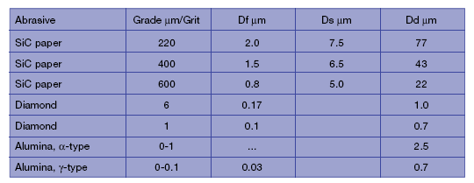
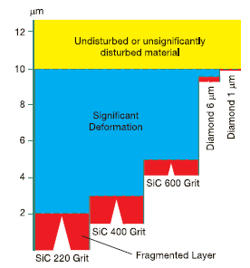
Sample preparation for specific material characterization
Sample preparation for microscopic evaluation
Depth of deformation (Dd):
Maximum depth beneath the root of the surface scratches to the elastic-plastic boundary.
Depth of significant deformation (Ds):
  Maximum depth beneath the root of the surface scratches of the deformation that will noticeably affect the observations to be made on the finished surface.
Depth of fragmented layer (Df):
Approximately equal to the depth of the surface scratches.

Slide 19
Sample preparation for specific material characterization
Sample preparation for microscopic evaluation
SiC fibres in Ti-alloy
After fine grinding
After rough polishing
After polishing
After final polishing

Slide 20
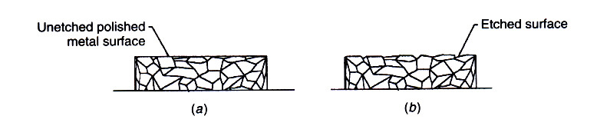
Sample preparation for specific material characterization
Sample preparation for microscopic evaluation
Chemical and Thermal etching
Polished unetched samples can show macroscopic cracks, pits, etc., and no microstructural details can be observed.
Therefore, a so-called etching process is needed to reveal the microstructures. Etching for microstructural evaluation is to expose the lowest-energy surface by chemical or thermal means.
Etching will expose defects such as grain boundaries and bring out the contrast between different phases or different crystallographic orientations that etch at different rates.

Slide 21
Sample preparation for specific material characterization
Sample preparation for microscopic evaluation
Definition of a “ true structure ”
Based on Vilella and Samuels, the true structure can be defined as:
No deformation
No scratches
No pull-outs
No false structures (artifacts)
No introduction of foreign elements
No smearing
No relief or rounded edges
No thermal damage
L. E. Samuels, Metallograhic Polishing by Mechanical Methods, American Society for Metals, Metals Park, Ohio (1982)
J. R. Vilella, Metallographic Technique for Steel, American Society for Metals,
Cleveland, Ohio (1938)

Slide 22
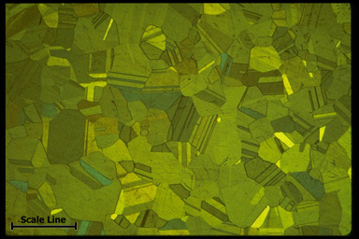
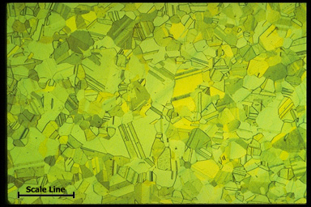
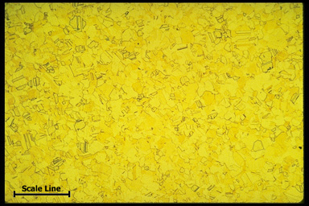
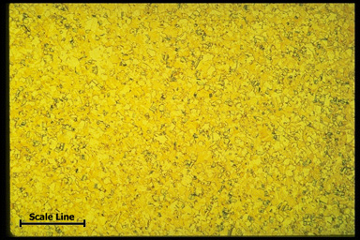
Sample preparation for specific material characterization
Microstructures of copper alloys
500 μm
500 μm
Grain size: 0.175 mm
Grain size: 0.120 mm
500 μm
500 μm
Grain size: 0.06 mm
Grain size: 0.030 mm

Slide 23
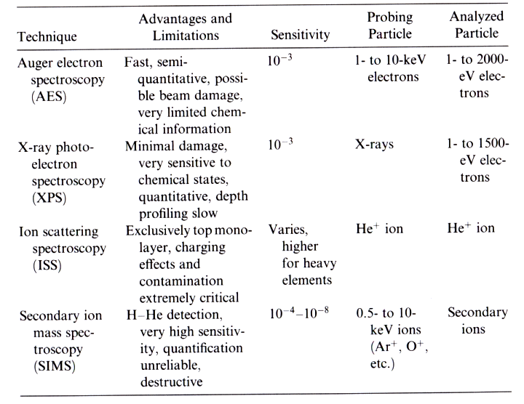
Sample preparation for specific material characterization
Surface spectroscopy

Slide 24
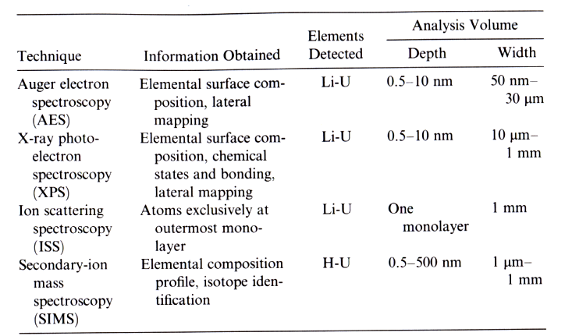
Sample preparation for specific material characterization
Surface spectroscopy

Slide 25
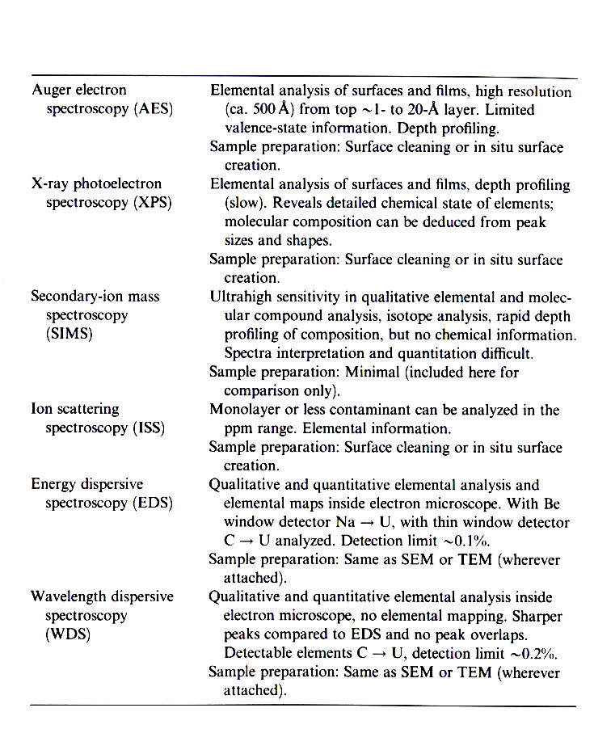
Sample preparation for specific material characterization
Sample preparation for surface spectroscopy

Slide 26
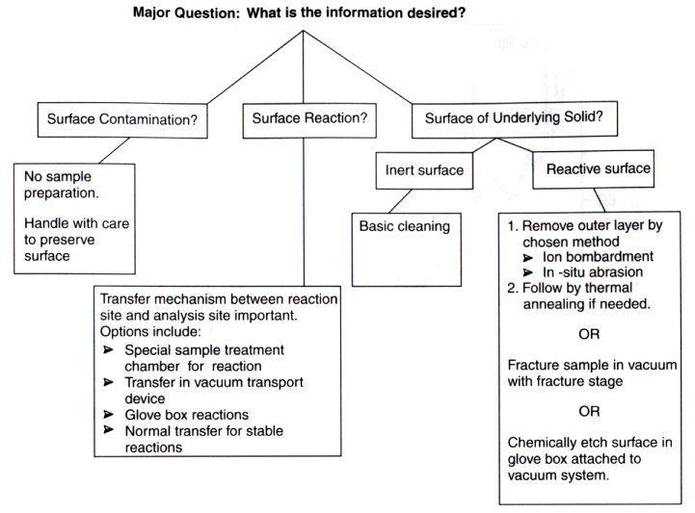
Sample preparation for specific material characterization
Sample preparation for surface spectroscopy

Slide 27
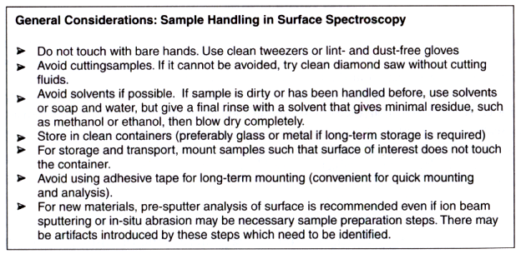
Sample preparation for specific material characterization
Sample preparation for surface spectroscopy
Sample handling

Slide 28
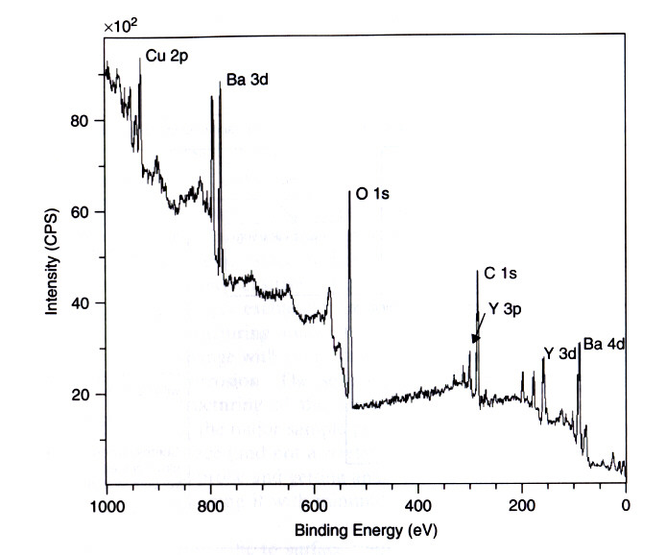
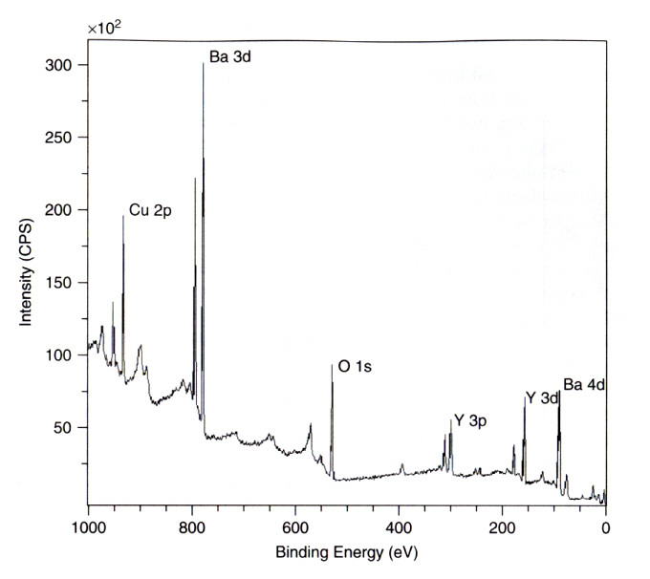
Sample preparation for specific material characterization
Sample preparation for surface spectroscopy
Special sample cleaning: ion sputter cleaning
Before sputter cleaning
After sputter cleaning
Sample: Thin film superconductor

Slide 29
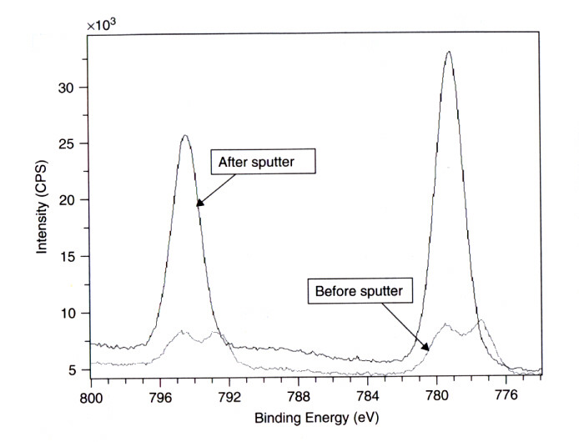
Sample preparation for specific material characterization
Sample preparation for surface spectroscopy
Special sample cleaning: ion sputter cleaning
Ba 3d XPS spectra
Surface contaminants like
Ba hydroxides and carbonates are removed by ion sputter cleaning

Slide 30
Sample preparation for specific material characterization
Sample preparation for surface spectroscopy
Other special sample preparation methods for surface analysis
In-situ heating
Refractory metals and silicon surfaces can be cleaned sufficiently by flash heating, that is heating the samples to a very high temperature for a very short time whereby the surface oxides becomes unstable and vaporize in vacuum.
In-situ abrasion and scraping
A razor blade or a grinding tool is attached at an appropriate angle to rotating or sliding shafts inside the vacuum system to grind the sample surface.
In-situ cleavage
Some crystalline materials have preferred cleavage planes that can be cleaved easily inside the vacuum chamber using a blade or a rod.

Slide 31
Short review on sample prep
Methods
Cutting/slicing
Mechanical polishing
Chemical etching
Thermal etching
Ion etching
Purpose
Shaping/Thinning down
Making it flat
Cleaning it up
Questions to think about
Tricks when sample is thin?
How to prepare the peacock feather sample? (soft materials)
How to make a cross-sectional sample?

Slide 32
PHYS 5350 techniques in materials characterization
Creating vacuum environment

Slide 33
Basic requirements to study surfaces
--The need of vacuum
Physical phenomena in “vacuum”
Definition of vacuum
Generation and maintenance of vacuum

Slide 34
The need of vacuum
Important terminologies
I. Mean free path
  It is the average distance that a molecule travels in a gas between two successive collisions with other molecule of that gas.
II. Molecular incident rate (or impinging rate)
  It is the number of molecules striking the surface per unit area per unit time
III. Monolayer formation time
  It is the time required for a freshly cleaved surface to be covered by a layer of the gas of ONE molecule thickness.

Slide 35
Ideal gas vs. Real gas
Ideal gas
The molecules are minute spheres.
Their volume is very small compared with that actually occupied by the gas.
The molecules DO NOT exert forces on each other.
The molecules travel along rectilinear paths in a perfectly random fashion.
The molecules make perfectly elastic collisions.
Real gas
Each molecule has certain significant volume which exclude other molecules.
There are intermolecular forces among the molecules.
These interactions lead to phenomenon such as condensation, vaporization, melting, freezing, and etc
Random but inelastic collisions are expected among molecules.

Slide 36
Gas Laws
I. Boyle’s Law [Boyle (1662) & Mariotte (1679)]
Boyle’s Law is valid for gases at all temperature except at above the “critical point”.
The “critical point” is the temperature above which the gas cannot be liquefied at any pressure.
II. Charles’s Law [Charles & Gay-Lussac (1802]
P_{T} = P₀ (1 + βt_{c}) and V_{T} = V₀ (1 + βt_{c});
P₀ and V₀ are pressure and volume at t_{c} equal to zero; and t_{c} = β⁻¹ + T (in degree);
β is equal to 1/273;
III. General Gas Law
R is the universal gas constant, N is the no. of moles of molecules/unit volume, k is the Boltzmann constant (k = R/N_{A}), N_{A} is the Avogradro’s number n is thus the number density;

Slide 37
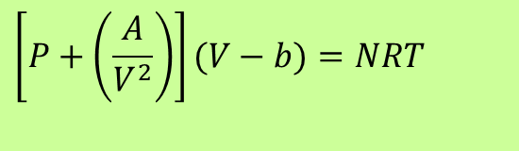
IV. Equation of state of real gas
Introduced by van der Waals;
The term (A/V²) takes into account the attractive forces between molecules, which have the same effect as an addition pressure;
The term (V-b) is the reduced volume, where b is the volume occupied by the molecules.
$$\left[P+\left(\frac{A}{V^{2}}\right)\right](V−b)=NRT$$

Slide 38
Maxwell-Boltzmann
velocity distribution of gases
I. Probability density function of distribution of gas velocity
in one direction
in 3 directions
II. Probability that a particle having a speed between ν and ν + dν
where f(v) is also the fraction of the number molecules having a speed between v and v+dv.

Slide 39
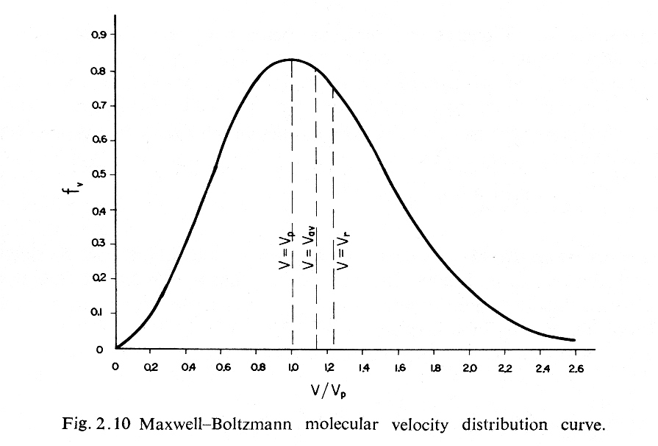
Derive the most probable velocity V_{p} , the average velocity, V_{av}
and the root-mean-square velocity, V_{r} .
F_{v}

Slide 40
The most probable velocity, v_{p}, is the speed most likely to be possessed by any molecule in the system and corresponds to the maximum value of F(v)
The mean velocity is the mathematical average of the speed distribution
The root mean square velocity, vrms is the square root of the average squared velocity

Slide 41
Molecular incident rate
Recall: n = number density = no. of molecules/unit volume
n_{x} = no. of molecules/unit volume in x-direction
Therefore, no. of molecules striking the surface per unit area per unit time is:
[molecules/cm²sec]

Slide 43
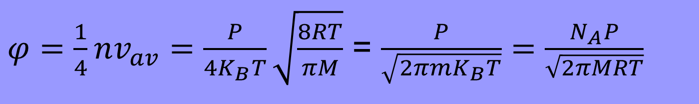
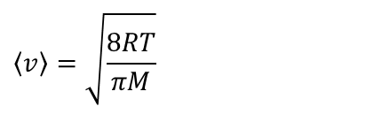
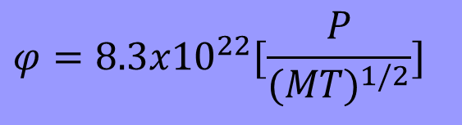
$$φ=8.3x10^{22}[\frac{P}{(MT)^{1/2}}]$$
or
PV=Nk_{B}​T
N is the number of molecules. The number density n=N/V
n=P/ k​_{B}T
$$\left\langle v\right\rangle =\sqrt{\frac{8RT}{πM}}$$
$φ=\frac{1}{4}nv_{av}=\frac{P}{4K_{B}T}\sqrt{\frac{8RT}{πM}}$ = $\frac{P}{\sqrt{2πmK_{B}T}}=\frac{N_{A}P}{\sqrt{2πMRT}}$

Slide 44

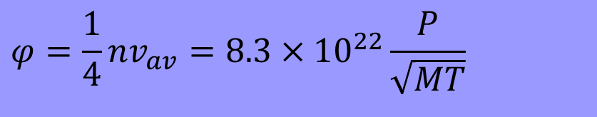
Monolayer formation time τ
$$φ=\frac{1}{4}nv_{av}=8.3×10^{22}\frac{P}{\sqrt{MT}}$$
where P in Pa and M in kg.
Assuming that the sticking coefficient is 1 and one monolayer contains 10¹⁹ particles/m², we get
$$τ=1.2×10^{−4}\frac{\sqrt{MT}}{P}$$
[unit: second]

Slide 45
Definition of vacuum
  Latin word, means “empty”
  In general term, “vacuum” means P < 1 atmospheric pressure.
  In 1958, “vacuum” was defined by the American Vacuum Society (AVS) as follow:
  Vacuum refers to a given space filled with gas at pressure
  below the atmospheric, i.e. having a density of molecules less than about 2.5 x 10¹⁹ molecules per cm³.

Slide 46
Characteristics of “vacuum”
  Low density of gas molecules
  Long mean free path of gas molecules
  High bombarding rate on all surfaces
  Weak interaction between molecules
Pressure units
1. Pascal (Pa): N/m², SI unit.
2. Torricelli (Torr): The pressure exerted by a column of Hg 1 mm high.
  3. Bar (bar): Std. Atmospheric pressure
1 bar ~ 1 atm ~ 101325 Pa ~ 760 Torr

Slide 47
Classification of vacuum
I. Low (& medium) vacuum
  The number of molecules in gaseous phase is large compared with that of covering the surfaces, thus in this range the pumping is directed towards rarefying the existing phase.
II. High vacuum
  The gas molecules are located principally on surfaces, and the mean free path equals or is greater than the pertinent dimensions of the enclosure. Therefore the pumping consists in evacuating or capturing the molecules leaving the surface and individually reaching pump. This is the range where particles can travel in vacuum enclosure without colliding with other particles.
III. Ultra-high vacuum
  In this regime, the time to form a monolayer on a clean surface is equal or larger than the usual time for laboratory measurement, thus “clean” surface can be prepared and their properties can be determined before the adsorbed gas layer is form.
Pressure range: Atmospheric pressure to 10⁻³ Torr
Pressure range: 10⁻³ to 10⁻⁷ Torr
Pressure range: 10⁻⁷ Torr or lower

Slide 48
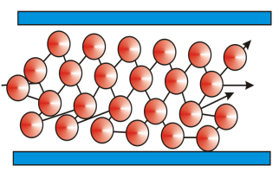
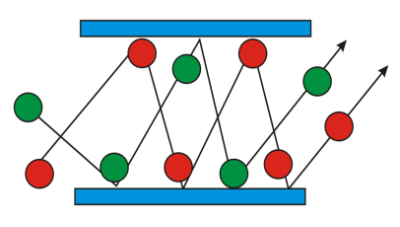
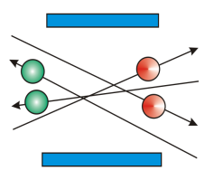
LOW VACUUM
LOW VACUUM
HIGH VACUUM
HIGH VACUUM
ULTRA VACUUM
ULTRA VACUUM
Rough Vacuum
Rough Vacuum
Fine Vacuum
Fine Vacuum
760
760
–
–
1 Torr
1 Torr
1
1
–
–
10
10
Torr
Torr
10
10
–
–
10
10
Torr
Torr
less 10
less 10
Torr
-
Torr
-
3
3
-
-
3
3
-
-
8
8
-
8
-
8
×
×
×
133
×
6
133
–
–
0.133 Pa
0.133 Pa
Less 10
1.01
Less 10
Pa
Pa
1.01
10
10
–
–
133 Pa
133 Pa
0.133
0.133
–
–
1.33
1.33
10
10
Pa
5
Pa
-
6
-
5
-
-
6
6
L < D
Λ < D
L ~ D
Λ ~ D
L > D
Λ > D
L >> D
Λ >> D
τ
τ
τ
τ
τ
τ
τ
<< 1s
τ
<< 1s
< 1s
< 1s
~ 1s
~ 1s
> 1s
> 1s
Volume Processes
Volume Processes
Intermediate and Surface Processes
Intermediate and Surface Processes

Slide 49
Realization of vacuum
A vacuum in a vacuum chamber is generated by a series of pumping through a series of pipes, feedthroughs, fittings and valves and the pressure is monitored by appropriate pressure gauges.
Use of proper gauges for different pressure ranges
Gauge
Proper pipes, feedthroughs, fittings and valves to direct and control the flow of vacuum line and seal the vacuum.
Proper combination of pumps to generate the the desired vacuum.
A close system of chamber and pipelines
Pumping system
Suitable vacuum materials for chamber construction

Slide 50
Materials used in vacuum
Criteria:
able to sustain the pressure difference
low trapping of other gaseous molecules
low vapour pressure
bakeable (up to 200 ºC)
easy to machine
Commonly used materials:
Metals: Al, Mo, O-free Cu, and etc.
Alloys: 5052 (Mg-Cr), 6061 (Cu-Si-Mg-Cr), stainless steel, and etc.
Polymers: Viton, Teflon, Silicon, PTFE, and etc.
Ceramics: Alumina, sapphire, Kovar (Fe-Ni-Mo-Mn), and etc.

Slide 51
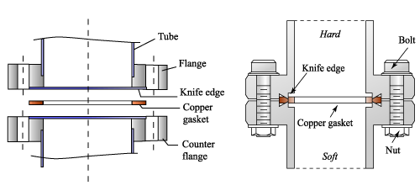
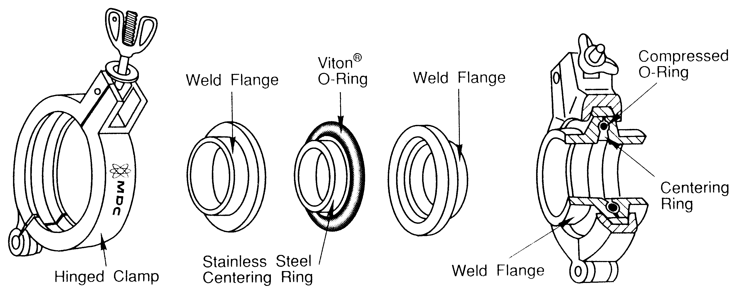
Sealing
ConFlat fittings
KF fittings

Slide 52
Pumps
Classification of pump:
A. Positive displacement pump
Low vacuum
(viscous regime)
rotary pumps;
diaphragm pumps, and etc.
B. Momentum transfer pump
Very high vacuum
(molecular regime)
turbomolecular pumps;
diffusion pumps, and etc.
C. Capture pump
ionization pump;
titanium sublimation pump;
cryogenic pump, and etc.
Ultrahigh vacuum
(molecular regime)

Slide 53
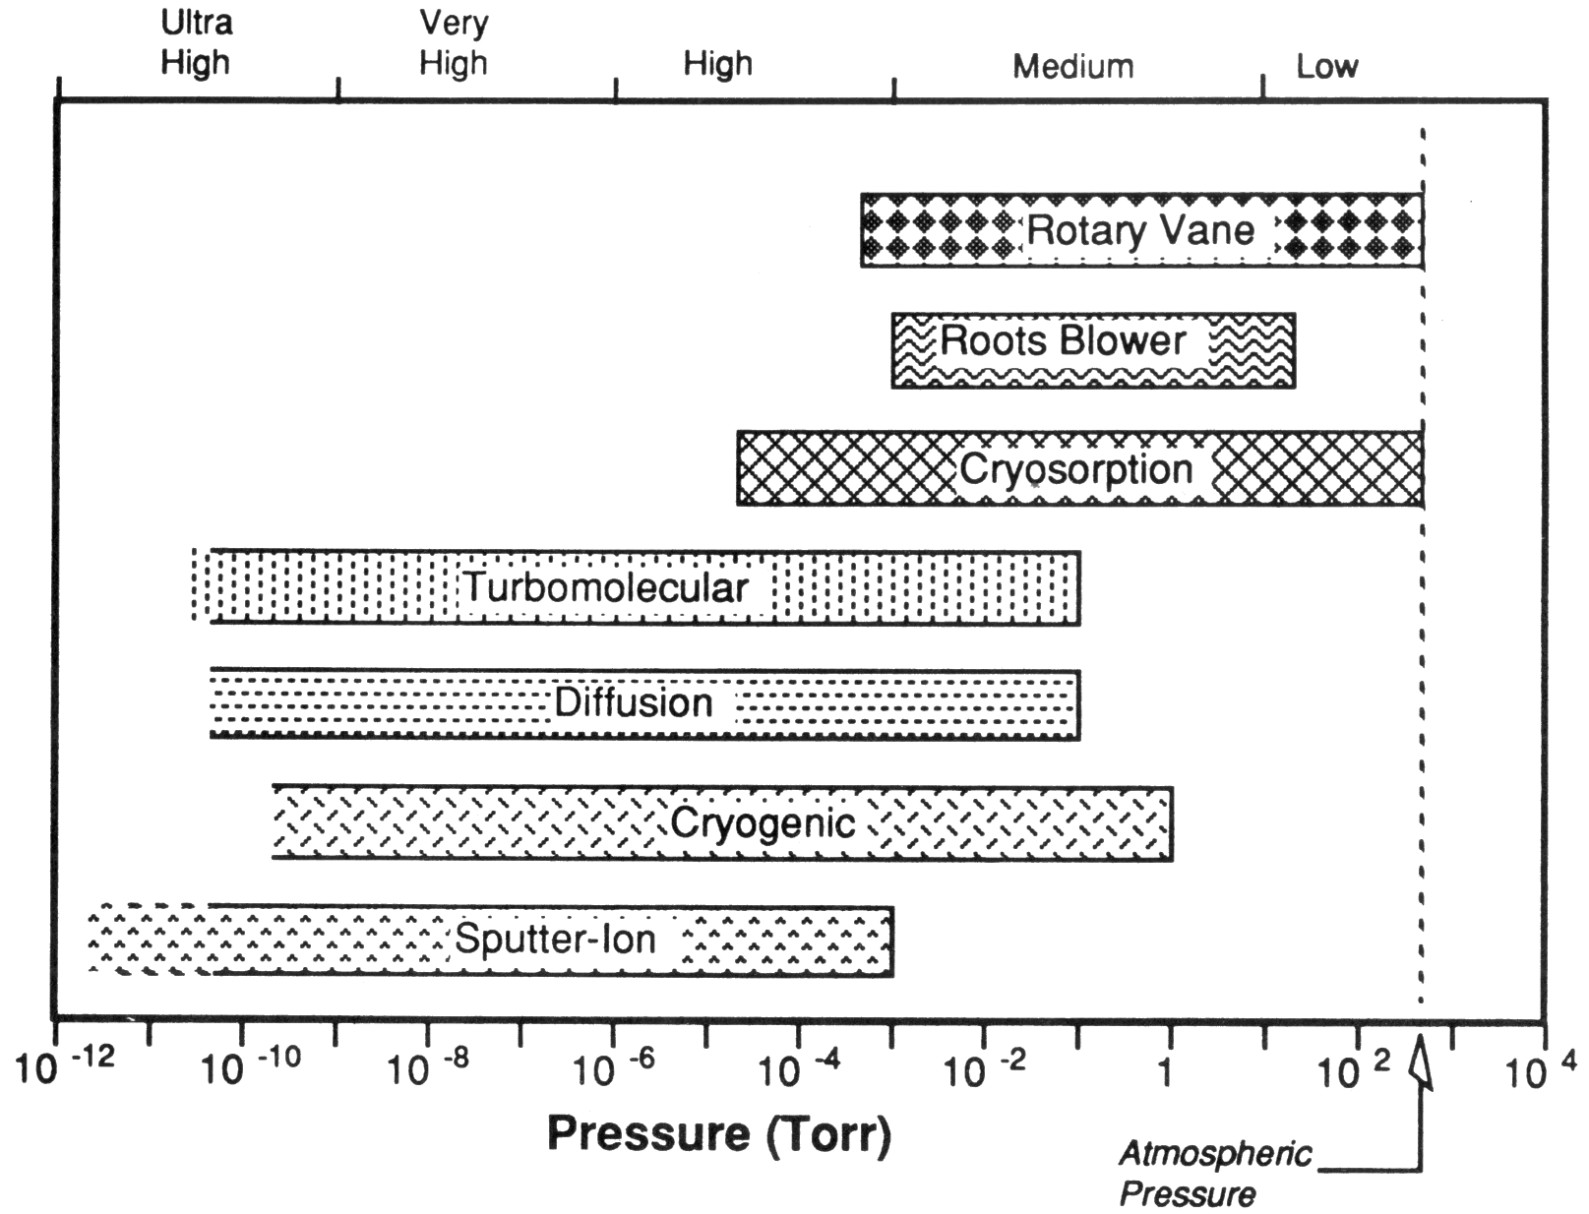

Slide 54
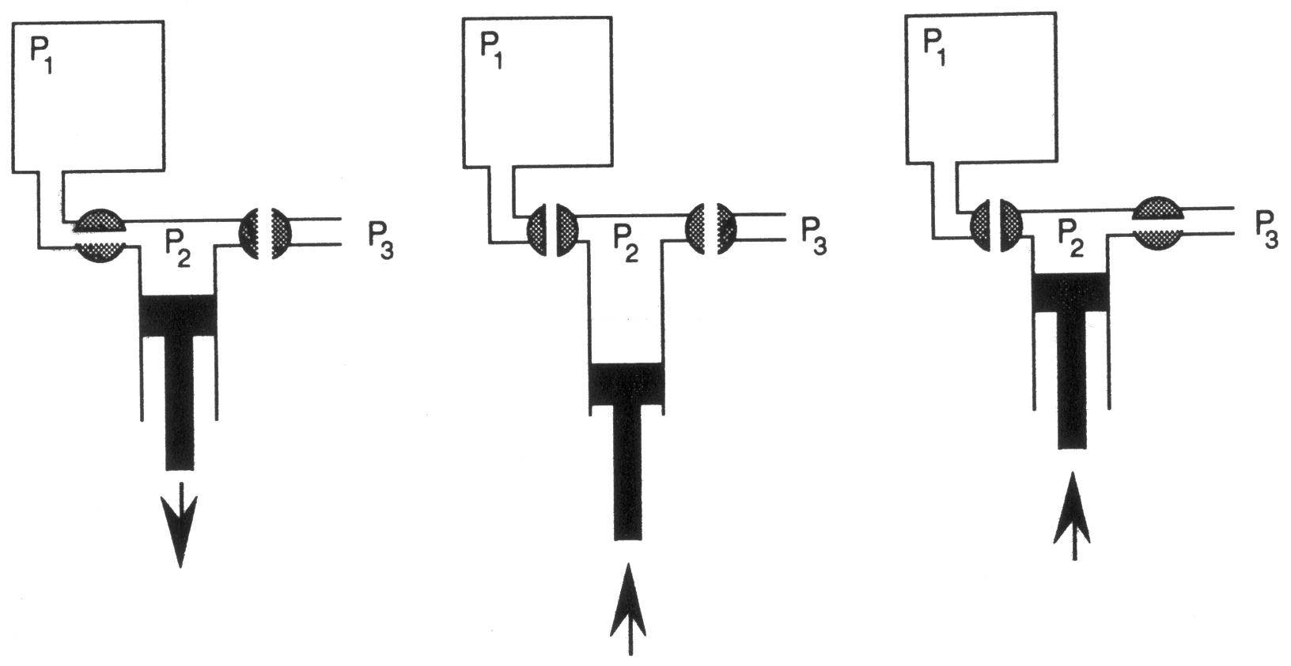
Pumping mechanisms
1. Positive displacement pump:
pumping gas out volume by volume
working range: atm. to ~10⁻² Torr.

Slide 55
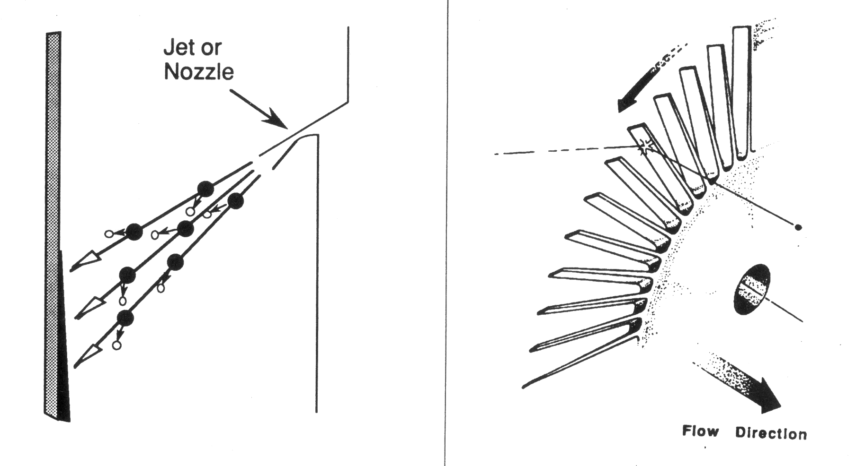
2. Momentum transfer pump:
impose a certain momentum onto gaseous molecules, so that they move in a particular direction
working range: ~10⁻² to ~10⁻⁸ Torr

Slide 56
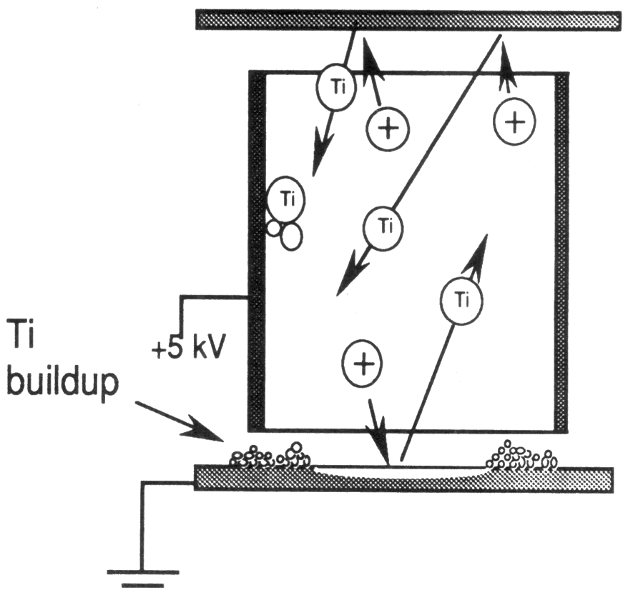
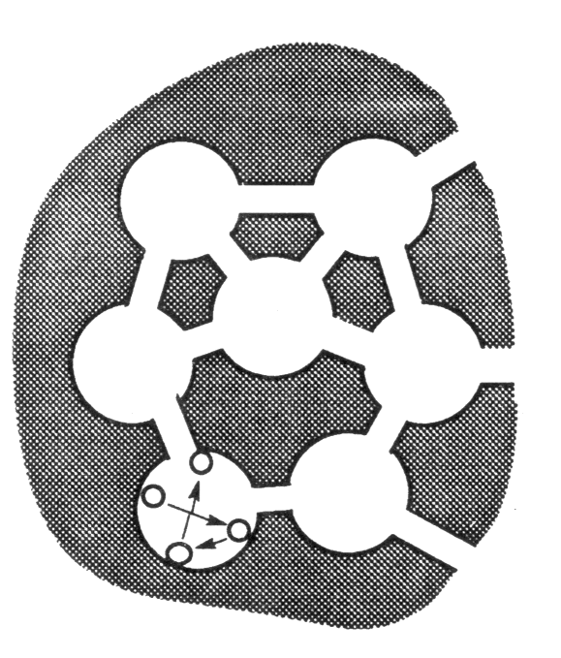
Capture pump:
capture the gaseous molecules through burying, gettering and sorption by reactive or cold surfaces
normal working range: ~10⁻⁶ to ~10⁻¹⁰ Torr, some sorption pump can work in low pressure range

Slide 57
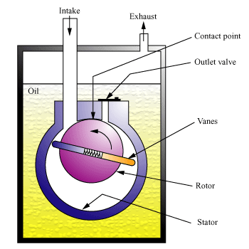
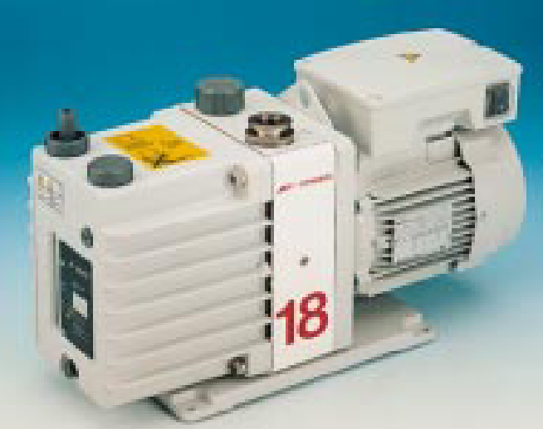
Examples of different pumps
1. Positive displacement pump: Rotary pump

Slide 58
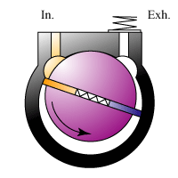
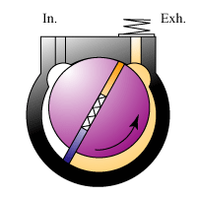
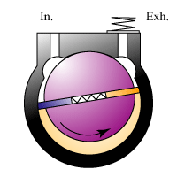
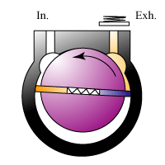
Inlet: As the vane passes at the inlet port, the volume of the inlet compartment increases.
Transfer: The gas molecules trapped in the compartment between the two vanes, is transferred to the exhaust as the rotor rotates.
Compression: The gas is compressed until the outlet valve is opened.
Exhaust: When the pressure of the compression compartment is sufficiently high (>113 kPa) to open the outlet valve, the gas is expelled into the oil casing.
1
3
2
4

Slide 59
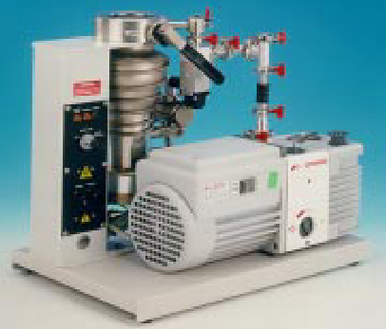
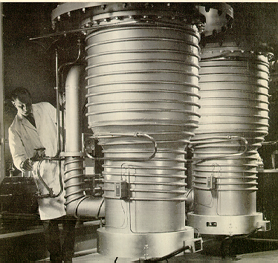
2. Momentum transfer pump: Diffusion pump

Slide 60
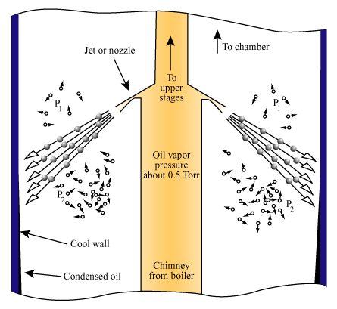
While the pumping fluid molecules move in a very directed motion (speed ~300m/s), the vapor molecules impart a momentum in the preferred direction to any gaseous molecules which they encounter.
Because of the large molecular weight of the vapor molecules, they also continue in their original direction after encounter with the residual gas molecules. The residual gaseous molecules thus gain a downward momentum and are eventually expelled out.
The pumping fluid strike the cool wall, they condense to form a liquid, and run down the pump wall to the reservoir to again heated by the boiler.
A vapor of the pumping fluid with a pressure of the order of 0.5 Torr in the chimney is generated; the molecules of the pumping fluid are ejected at velocities of the order of 300m/s.

Slide 61
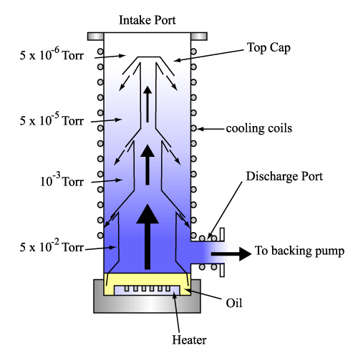
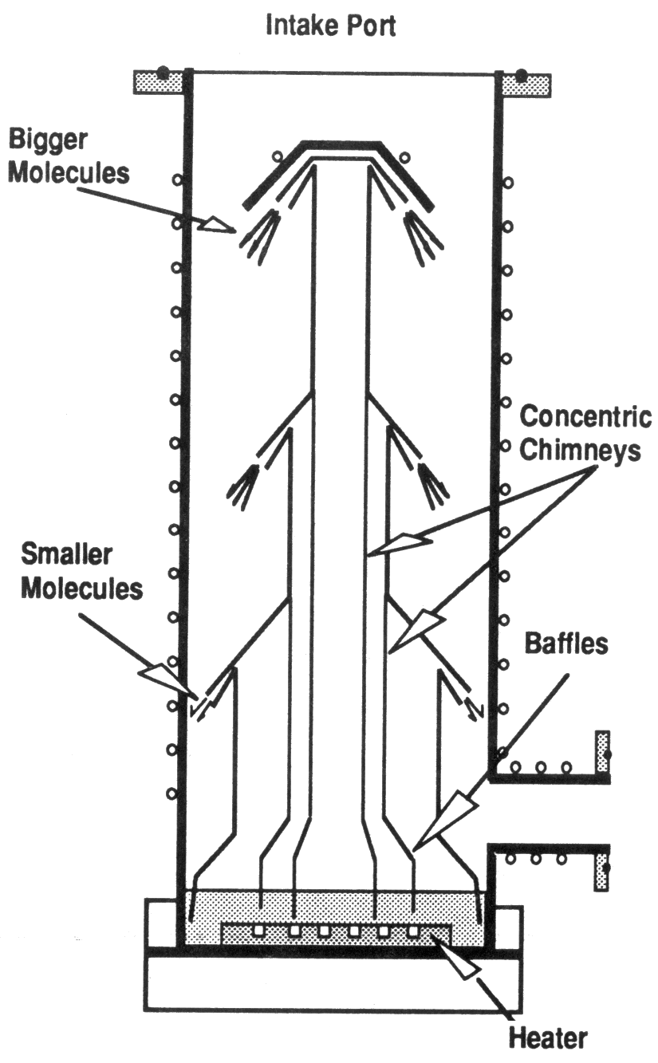

Slide 62
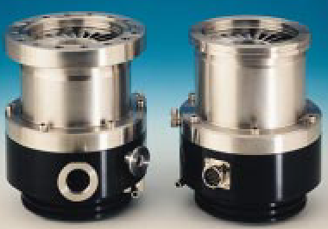

2. Momentum transfer pump: Turbomolecular pump

Slide 63

The moving blades moving with a comparable speed to that of molecules strike the molecules and knock them in the preferred direction;
in fact, the molecules do not “bounce” on the blades, but they first adsorb on the blade surface and then desorb from the surface;
on a stationary blade, molecules desorbing from both sides of the blade have the same velocities;
on a moving blade with velocity, the molecules desorb from one side (lower side in the figure) have high velocities but that desorb from the other side have nearly zero velocity.

Slide 64


Slide 65



3, Capture pump: Ionization pump

Slide 66



Slide 67

a free electron is accelerating towards the anode. When the electron acquires sufficient energy and when it strikes a molecule, it can ionize the molecule and create an electron and a positive ion. When the electron strikes the anode, it is removed from the process.
in order to increase the pathlength of electrons so that the ionization process is enhanced, the electron is allowed to pass through the hole in the ring positively biased. The electron will then follow oscillatory motion instead of directly striking the anode.
an additional magnetic field provides a force on the electrons which is perpendicular to the direction of motion and causes the electrons to move in a spiral path. Thus, the probability for the electron to have collision with other molecules is greatly increased.

Slide 68

Sputtering
The positive ion is accelerated by the cathode and strikes the surface. The process knocks out the Ti atoms on the cathode. The sputtered Ti atoms will deposit in the cell. Metallic Ti is also exposed on the sputtered surface.
2. Gettering
Metallic Ti is very reactive. The gas molecules adsorb on the surface.
3. Burial
The sputtered Ti atoms bury the molecules that already adsorbed on the surface. This burial is the pumping mechanism for noble gases and other inert molecules.

Slide 69

3. Capture pump: Titanium sublimation pump
A high current passes through a titanium rod. The current heats up the Ti metal and generates Ti vapor. New Ti surface is continuously created on the inner walls of the pump.

Slide 70


3. Capture pump: Cryogenic/Sorption pump
the principle is based on the physi-sorption of gases on a chilled surface
clean, contamination free

Slide 71

Gas molecules trapped in a molecular sieve of a cryogenic pump, which is cooled down to liquid nitrogen. The cryogenic pump pumps down from the atmospheric pressure to 10⁻⁶ Torr.

Slide 72

Pressure gauges

Slide 73

Direct gauge: Mercury manometer

Slide 74


Indirect gauge: Thermal gauges
Thermal gauges measure the pressure indirectly by detecting the thermal (or cooling) effect on various parameters, e.g. temperature, resistance of wire, capacitance, and etc., when the gauge is attached to a system under different vacuum state.
Working pressure: Atm - 10⁻⁴ Torr
Thermocouple gauge
Notes:
wire will become hotter and hotter as the
pressure drops and fewer and fewer molecules are available to transfer heat
away from the wire.
pressure range of about 10-3 – 1 torr. Below this range, heat transfer is mostly by
radiation from the wire’s surface and mostly by thermal convection above it.
Thermal conductivity gauges covering this range have been in use for many
years that fall into two main groups: thermocouple gauges and Pirani gauges.
Pirani gauges also take advantage of the change in temperature of a heated
wire, but unlike thermocouple gauges, they don’t measure the wire temperature
directly. Instead they make use of the fact that the resistance of a metal wire
changes with the wire’s temperature

Slide 75



Indirect gauge: Hot cathode gauges
electrons are generated from the filament
the electrons will collide and ionize the residual gas molecules
the ions will be collected by the negatively biased ion collector
for a higher pressure, more ions will be generated, leading to a higher detected current from the ion collector
thus, the pressure can be revealed in term of the collector current
usually, a positively biased grid is added to increase the pathlength of electrons so that the ionization is enhanced;
working pressure: <10⁻⁴ Torr.

